Slide 1
Task Team 25 Mail Quality Data via Informed Visibility FAQ
December 3, 2018

Slide 2
Table of Contents
FAQ Questions Overview
FAQ Q&A
Appendix
a. MQD Data Dictionary
b. IV Mail Tracking MQD Data File Formats Data Feeds (Subscriptions)
c. IV Mail Tracking MQD File Name Codes
d. Approximate Provisioning Run Times by Program/Frequency
e. Feed Creation Walkthrough

Slide 3
FAQ Questions Overview
How do I signup to receive MQD data?
How do I create an MQD feed?
How do I associate more than one CRID to an MQD feed?
Where can I find details on error data?
When will I receive my Daily/Weekly/Monthly data?
Why do I have discrepancies between IV and mailer scorecard?
When will the scorecard match IV’s data?
What do the MQD file names mean?
Why do I have duplicate file content for different feeds?
How do I update email address for existing feeds?
Why am I receiving Monthly data over files between days?
Why am I receiving Monthly data files daily?
How are inactive errors handled?
For which mailer role does the scorecard account?
How do I update multiple MQD feeds simultaneously?
How do we find out about future MQD enhancements?

Slide 4
FAQ Q&A
Q: How do I signup to receive MQD data?
A: In order to receive MQD data, users must first be signed up for Informed Visibility Mail Tracking service via the Customer Registration Gateway.
Q: How do I create an MQD feed?
A: To create/edit subscriptions users must be either BSA/BSA delegate. Likewise Report and Subscriptions Manager roles can be delegated to allow MQD subscription feed modifications. Please see the tutorial in the appendix for detailed steps of the feed creation process.
Q: How do I associate more than one CRID to an MQD feed?
A: Users are currently required to designate each error feed to one respective CRID. Future enhancements are in the backlog to allow multiple CRID associations as with Scan Data subscriptions.

Slide 5
FAQ Q&A continued
Q: Where can I find details on error data?
A: Error data details can be found in the appendix section – MQD Data Dictionary attachment. This document provides insight into applicable fields for each respective error as well as field implementation date, data format, field descriptions, etc.
Q: When will I receive my Daily/Weekly/Monthly data?
A: In general MQD data is pushed to users subscriptions as soon as IV has received the errors. For this reason, error data may arrive over multiple provisioned files. (Daily) Daily error data is provisioned by IV on a rolling basis. Data is sent from SASP/PO! once daily, please see attached table for program details. (Weekly) eInduction weekly data sends on Saturday for the previous week. Data generated between midnight the previous Saturday to Friday night 11:59 PM ET are provisioned in the weekly file. Any records that come in after Friday at 11:59 PM ET would be pushed into the next week’s file. Full Service, Seamless Acceptance & Move Update send weekly files on Fridays for the standard postal week, Saturday thru Friday. The Friday data can possibly be split if an error is logged after the workflow is started. (Monthly) Monthly error data begins provisioning on the 10th of each month and users can expect to have all of their monthly file data by the 12th.

Slide 6
FAQ Q&A continued
Q: Why do I have discrepancies between IV and mailer scorecard?
A: In MQD the mailer is able to receive errors in which they are either the eDoc Submitter, Mail Preparer, Mail Owner, or Transportation Carrier. MQD mailers would need to filter these errors out when comparing against the Mailer Scorecard.
Q: When will the scorecard match IV’s data?
A: The scorecard totals are calculated separately from IV MT. The data between scorecard and IV will only always match for Monthly files.
Q: What do the MQD file names mean?
A: The file nomenclature depends on the file format selected (Delimited File or JSON). Please see the appendix for an in-depth guide.

Slide 7
FAQ Q&A continued
Q: Why do I have duplicate file content for different feeds?
A: The cause of the same data being provisioned to two different feeds is due to how the feeds are configured to receive data. The general case is when feeds are created with all Mailer roles selected (eDoc Submitter, Mail Owner, Mail Preparer, Transportation Carrier). Any error record with matching CRIDs playing a given role is eligible to be provisioned to the respective CRID’s feed.
Q: How do I update email address for existing feeds?
A: Residual from a defect fix affects the feeds modification page. Any subscription created after 1/6/2018 requires an email address when Email Notifications are selected and as a result would not have this issue. In order to resolve the issue one of the two actions below need to be taken:
a. Uncheck both subscription Email Notification checkboxes
b. Select an email from the dropdown and save the feed

Slide 8
FAQ Q&A continued
Q: Why am I receiving Monthly data over files between days?
A: Feeds provision all the time because IV-MTR receives data daily. As remaining monthly data is received new files are generated to complete the monthly data set. When comparing scorecard totals, users should add the MQD file totals between files to ensure accurate counts.
Q: Why am I receiving Monthly data files daily?
A: A blank file will be generated as Frequency is set even if Source Frequency is more often. Users should not select a Frequency over 7 days else data may not be received by the feed.
Q: How are inactive errors handled?
A: Both Active and Inactive errors are included in the MQD monthly feeds. MQD mailers would need to filter inactive errors out when comparing against the Mailer Scorecard.

Slide 9
FAQ Q&A continued
Q: For which mailer role does the scorecard account?
A: The Mailer Scorecard and Legacy feeds only include errors where the mailer is the eDoc Submitter.
Q: How do I update multiple MQD feeds simultaneously?
A: Please note IV-MTR currently does not have functionality to replay these files with modifications made directly to the feed and therefore requires a manual file pull.
Q: How do we find out about future MQD enhancements?
A: Future IV-MTR enhancements will be communicated over the USPS PostalPro page. Enhancements include (but are not limited to) data dictionary updates, configuration changes, service notifications, defect fixes and new functionality.

Slide 10
Appendix Overview
MQD Data Dictionary
IV Mail Tracking MQD Data File Formats Proposed Data Feeds (Subscriptions)
IV Mail Tracking MQD File Name Codes
Approximate Provisioning Run Times by Program/Frequency
Feed Creation walkthrough

Slide 11
MQD Data Dictionary
Double click the MQD Data Dictionary Excel icon to view contents –
Sample MQD Data Dictionary view below:

Slide 12
IV Mail Tracking MQD Data File Formats Data Feeds (Subscriptions)
 | Delimited | JSON
File Extension | TXT | JSON
Program Types Available | Full Service Seamless Acceptance Move Update eInduction | Full Service Seamless Acceptance Move Update eInduction
Delivery Method | Sent to FTP/SFTP server | Sent to FTP/SFTP server, web service, or Online Download
Option to zip? | Yes | Yes
File Naming Convention | YYYYMMDDHHMMSS_MQD_<Program Type>_<Error Type>_<Source Frequency>_<4 random alphanumeric chars for Message Group>_<4 digits for Message #>.txt | YYYYMMDDHHMMSS_MQD_<Program Type>_<Error Type>_<Source Frequency>_<4 random alphanumeric chars for Message Group>_<4 digits for Message #>.json
Example File Name | 20161207112728_MQD_FS_BQ_M_2XY4_0001.txt | 20170616150100_MQD_SA_BQ_NS_D_141U_0001.json
Headers? | Yes | n/a
End of Line | Line feed (LF) “\n” | n/a
Delimiter | As selected by user—Note: Pipe delimited may be best option due to commas being included in error data | n/a
Handling of Large Number of Records | Multiple files created if more than 100,000 records | The current target is 250 scans per file for message in the message group.
Success/Failure Email Available? | Yes | No
Behavior if No Records | Blank file appears in Output History but not sent; email sent if “On Transfer Success” selected | No file will be sent, though there are enhancements in the future to send blank files.
Notes:
For a data feed, IV handles a large number of records as follows:
IV targets 100,000 records in a data feed file.
Example: If 400k records accumulated for a data feed for the next send interval, IV would first calculate how many files would be needed to cover the amount of records. In this case, 4. IV then randomly assigns records to one of the four files. Assignment is random, so one file may have 140k records while another has only 60k.

Slide 13
IV Mail Tracking MQD File Name Codes
Source Frequency | Short
Daily | D
Weekly | W
Monthly | M
Program Type | Short
Full Service | FS
Move Update | MU
Seamless Acceptance | SE
eInduction | EI
Error Type | Short
Barcode Uniqueness | BQ
By/For | BF
Delivery Point | DP
Duplicate | D
Entry Facility | EF
Entry Point Discount | EPD
Mail Characteristic | MC
MID | MID
Misshipped | M
Move Update | MU
Nesting/Sortation | NS
Payment | PYMT
Postage | P
STID | STID
Undocumented | U
Unlinked Copal | UC
Warning | W
Weight | WT
Zone | Z
MQD File Name Examples:
Read two files Full Service – Barcode Uniqueness – Daily:
20171019045510_MQD_FS_BQ_D_0F2D_0001.json
20171019045510_MQD_FS_BQ_D_0F2D_0002.json
Read 1 file for Seamless Acceptance – Nesting Sortation – Weekly:
20171020223045_MQD_SA_NS_W_0F2D_0001.txt

Slide 14
Approx. Provision Run Times by Program and Frequency
Program | Daily | Weekly | Monthly
Full Service | 12:30 AM | 10:30 PM | 8:15 PM
Move Update | 1:00 AM | 11:00 PM | 12:00 AM
Seamless Acceptance | 11:15 PM | 12:45 AM | 1:30 AM
Undocumented | 9:30 AM | 2:00 AM | 2:00 AM
eInduction | 2:30 AM | 2:30 AM | 3:30 AM

Slide 15
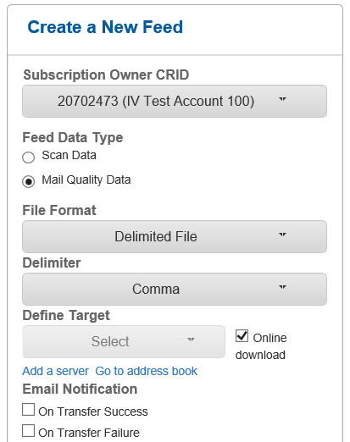
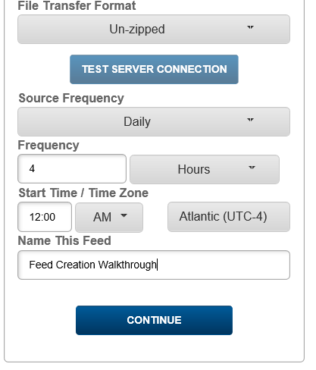
Feed Creation Walkthrough
Step 1 – Select details for Feed Data Type “Mail Quality Data”

Slide 16
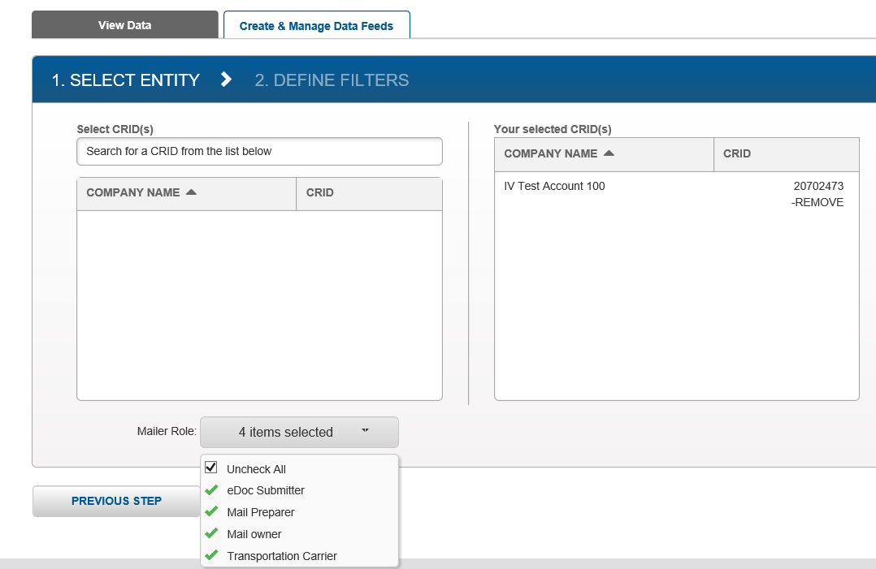
Feed Creation Walkthrough cont’d
Step 2 – Select CRID and affiliated Mailer Roles

Slide 17
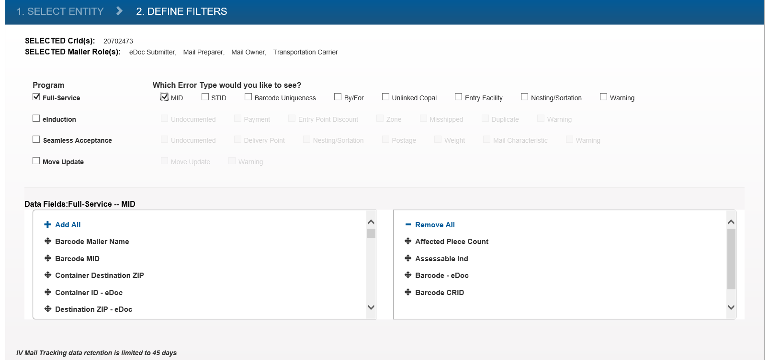
Feed Creation Walkthrough cont’d
Step 3 – Select Error Type(s) and define respective Data Fields

Slide 18
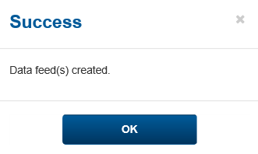
Feed Creation Walkthrough cont’d
Step 4 – Success confirmation prompt

Slide 19
Feed Creation Walkthrough cont’d
Step 5 – Search feed to download files, view details & modify feed

